Slide 1
WHEREVER, WHENEVER
flexit@flex-it.fit
www.flex-it.fit
Spring 2018
Confidential & Proprietary

Slide 2


36,540
Health and fitness clubs in the United States
The fitness space is facing disruption driving by the evolving needs of its customers
57.25 m
Members of health clubs in the United States
66%
Of gym members believe that their gym offers a poor price-to-performance ratio
Source: Statista, The Statistics Portal - 2016
Notes:
Other potential taglines:
The Fitness space is under attack by the needs of the dynamic customer
Trends in the fitness space are disrupting the status quo
The fitness space is facing disruption driven by the
Traditional gym models are under attack by the evolving needs of the customer

Slide 3
Problems for Gyms
Gym memberships are down.
Gyms are underutilized and almost always have excess capacity.
High fixed cost
Increasingly demanding customers that expect personalized service

Slide 4

Problems for Gym-Goers
Gym memberships are expensive and inflexible to the needs of the modern worker’s schedule
Difficult to find suitable workout facilities while traveling
Lack of use of a gym membership leads to feelings of guilt and self-doubt that further perpetuate a sporadic workout regimen

Slide 5
… and the industry is talking about
According to Club Industry’s “Future Gyms Report - Forward Five Years: How The Fitness and Wellness Industry Will Change” -- how disruptors, technology, demographics and other factors will influence the fitness industry during the next five years -- digital aggregators are the primary (of six) major entrants in the industry that will shake things up over the next five years.
ClassPass started the trend, and as of 2017, 26% of fitness operators base their business on these aggregators.
And this number is climbing at increasing rates.
Q: WHAT IS THE GREATEST THREAT TO THE FITNESS INDUSTRY TODAY, AND WHAT CAN THE INDUSTRY DO TO OVERCOME THAT?
A: In my opinion, there are actually two: the continued rise of boutique fitness, and the notion that fitness should be available to a consumer anywhere, anytime. People, especially millennials, are searching for personalized experiences and that includes looking for unique feverywhere they go, fitness and workout experiences with a small group of people they connect with on a personal level. Even if they’re traveling or away from home, they expect to be able to keep that routine by walking into a local boutique gym on a per-session basis or by using a digital fitness app outside, in a hotel – or almost anywhere for that matter.
Adam Zeitsiff, CIO - Gold’s Gym International
January 2018
Source: Club Industry, February 2018
Notes:
Club Industry Future Gyms Report

Slide 6
WHAT IF there was a solution that bridged the gap between gym facilities and its customers?
Notes:
Other potential taglines:
The Fitness space is under attack by the needs of the dynamic customer
Trends in the fitness space are disrupting the status quo
The fitness space is facing disruption driven by the
Traditional gym models are under attack by the evolving needs of the customer

Slide 7
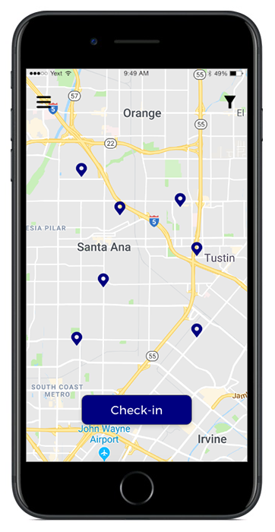
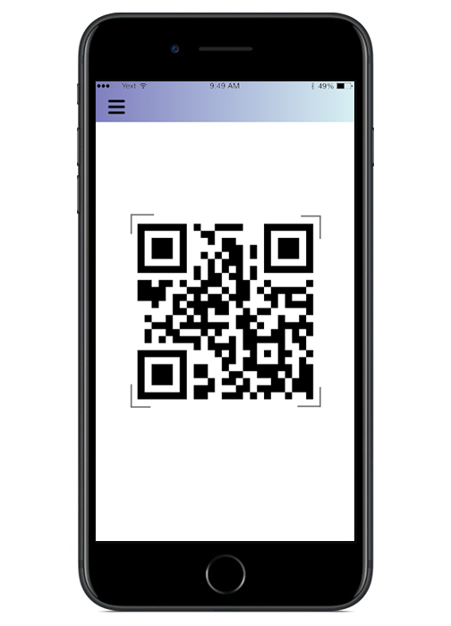
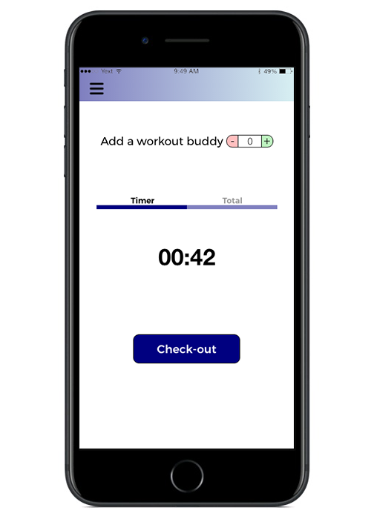
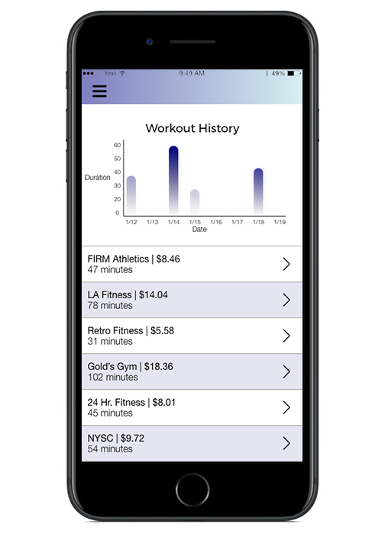
An a-la-carte, non-membership solution to access health & fitness clubs wherever, whenever
The FlexIt Customer Solution
Explore
Check-in
Timer
Workout Log
Notes:
Not actual screens, just visual representations.

Slide 8
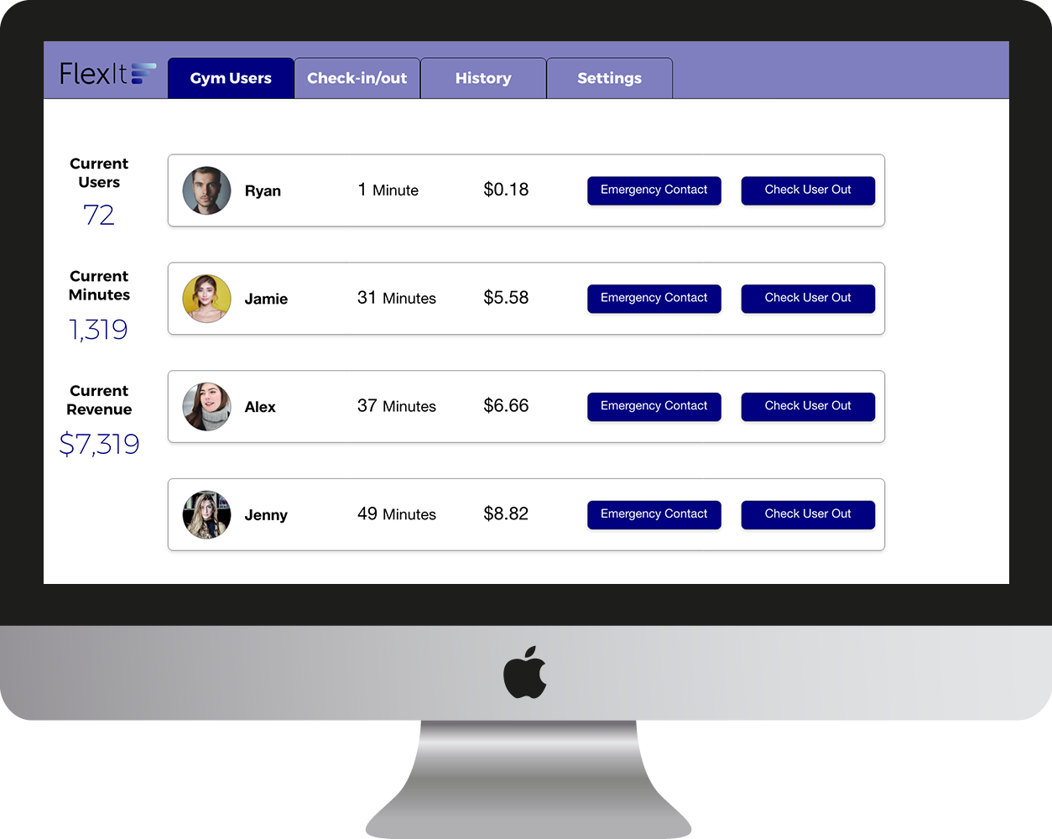
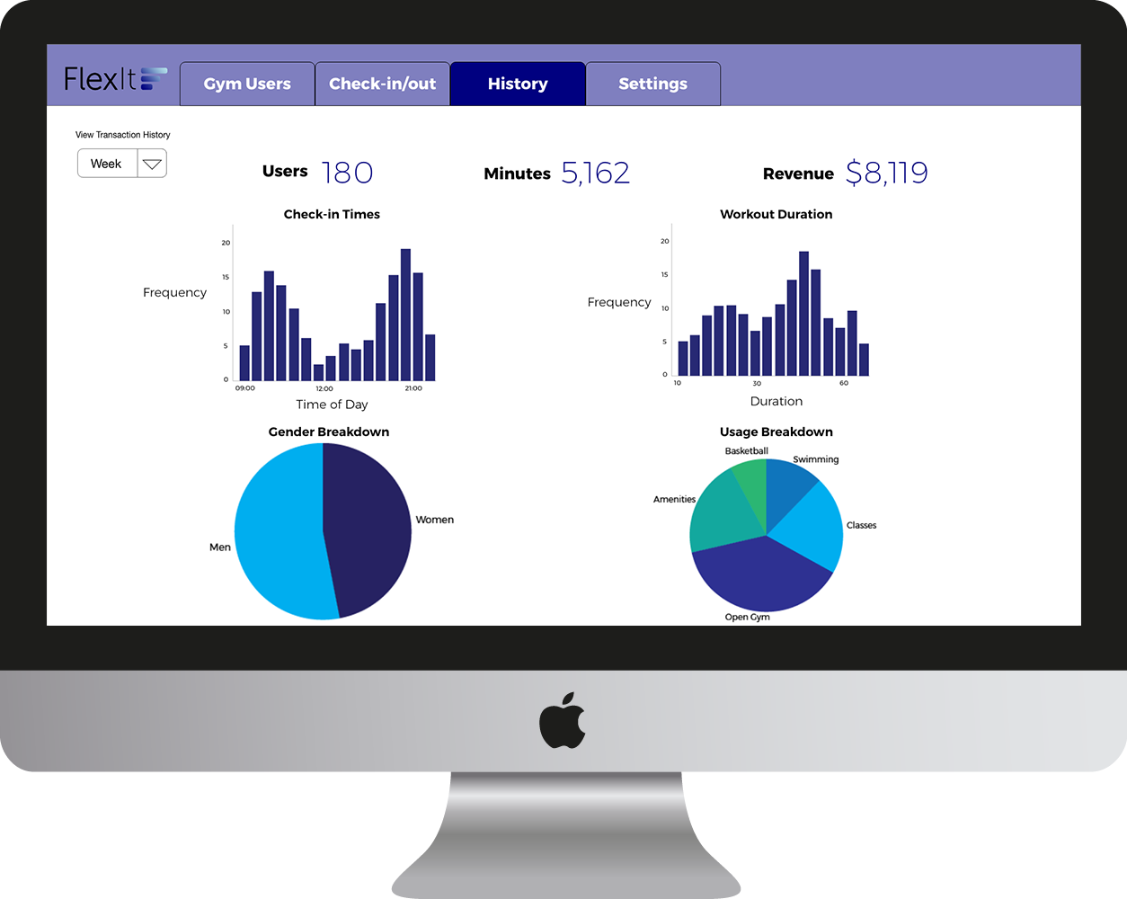
An a-la-carte, non-membership solution to access health & fitness clubs wherever, whenever
The FlexIt Gym Solution
Users
Data
Notes:
Not actual screens, just visual representations.

Slide 9
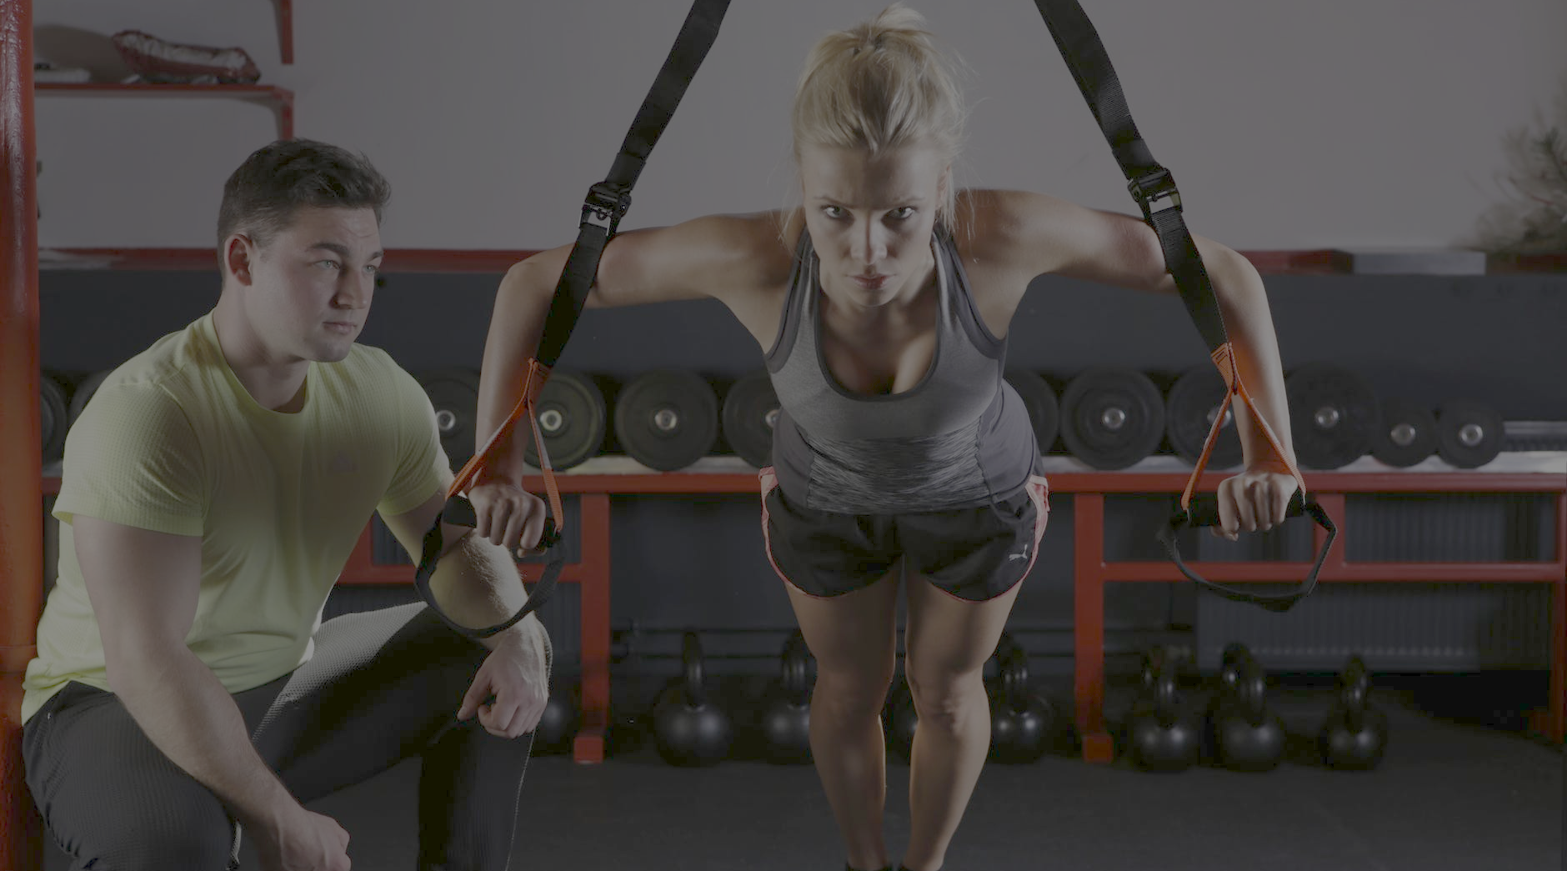




FlexIt provides on-demand access to gyms so that users can enjoy the privileges of membership without the hassle
Just choose a club, check-in, pay for the time you use, and check-out
Full control, maximum flexibility and convenience and access to all facility amenities
Benefits to Gym-Goers
Rates are by-the-minute and are more competitive and affordable than any other option in the market
Just choose a club, check-in, pay for the time you use, and check-out
Enjoy the privileges of membership without guilt or commitment
Full control, maximum flexibility and convenience and access to all facility amenities
Flexible
Rates are by-the-minute and are more competitive and affordable than any other option in the market
Convenient
Experiential
Affordable
Notes:
Not actual screens, just visual representations.

Slide 10






Benefits To Gyms
Increased revenue (via rev share)
New prospective touchpoints
Membership upticks
Benefits to Gyms
Increased foot traffic
Organic cross promotion and marketing
Notes:
Add personal training sessions here

Slide 11
Opportunity
Adults who work out
1-2x / week
US population
FlexIt user base
Prospective user-base (3Y pro-forma):
3,016,981
450K
USERS
Serviceable obtainable market:
60,339,636
Total available market:
326,160,198
Source: Statista, The Statistics Portal - 2016
Notes:
57.3
Need % that go to the gym less than 8x per month
Maybe concentric circles

Slide 12



Digital
Cost: $$$
Effectiveness: High
Customer Acquisition
Offline
Cost: $
Effectiveness: Medium
Partnerships
Cost: $$
Effectiveness: Low
Notes:
Let’s clean slides 13-15 up once the model is done
Based on experience

Slide 13




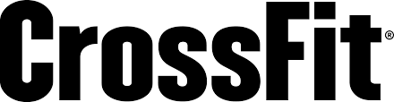

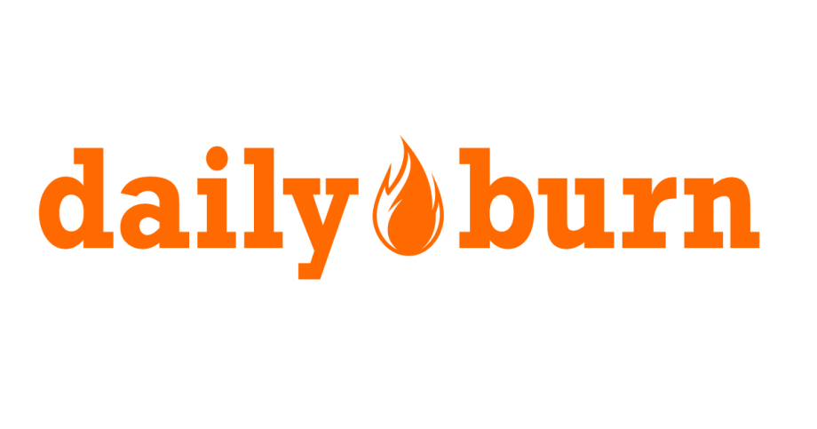

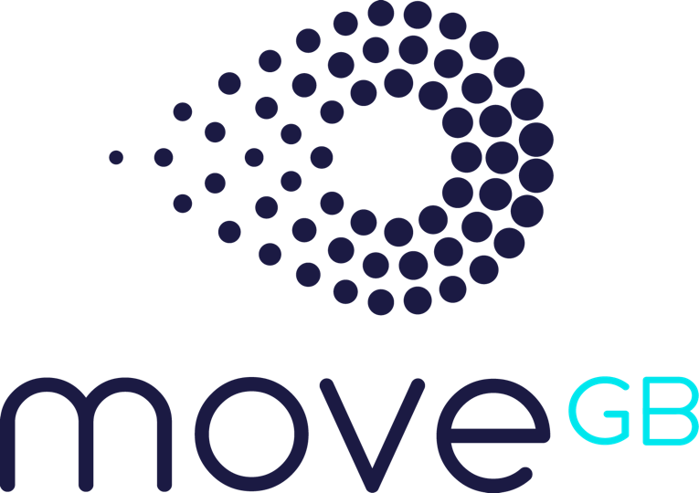

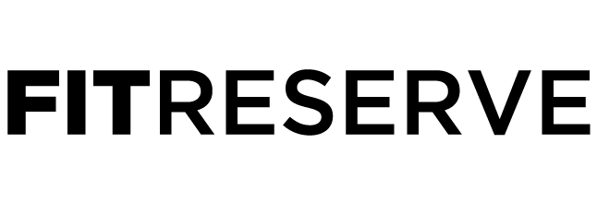

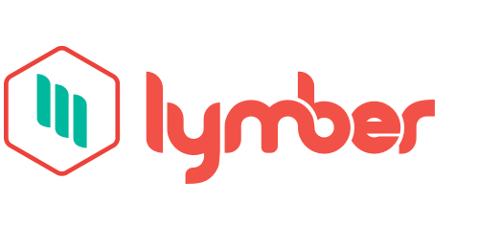


An a-la-carte, non-membership solution to access health & fitness clubs wherever, whenever
Fitness Ecosystem
Experiential
Expensive
Affordable
Functional
Notes:
Not actual screens, just visual representations.

Slide 14


CEO – Austin Cohen
Meet the
Team
Sed ornare at felis vel bibendum. Suspendisse suscipit quam in quam facilisis, et facilisis nisi pulvinar. Donec cursus efficitur mi, bibendum egestas nunc maximus sit amet.
TBD – Kevin Batista
Sed ornare at felis vel bibendum. Suspendisse suscipit quam in quam facilisis, et facilisis nisi pulvinar. Donec cursus efficitur mi, bibendum egestas nunc maximus sit amet.
Head of Biz Dev – Michael Rojas
Aliquam fringilla aliquet aliquet. Nulla facilisi. Proin ut pulvinar nisl. Pellentesque habitant morbi tristique senectus et netus et malesuada fames ac turpis egestas.

Slide 15
Advisory Board
Head of Biz Dev – Michael Rojas
Sed ornare at felis vel bibendum. Suspendisse suscipit quam in quam facilisis, et facilisis nisi pulvinar. Donec cursus efficitur mi, bibendum egestas nunc maximus sit amet.
Head of Biz Dev – Michael Rojas
Sed ornare at felis vel bibendum. Suspendisse suscipit quam in quam facilisis, et facilisis nisi pulvinar. Donec cursus efficitur mi, bibendum egestas nunc maximus sit amet.
Head of Biz Dev – Michael Rojas
Sed ornare at felis vel bibendum. Suspendisse suscipit quam in quam facilisis, et facilisis nisi pulvinar. Donec cursus efficitur mi, bibendum egestas nunc maximus sit amet.

Slide 16
Key Risks & Mitigants
Risks
Mitigants
Gyms feel threatened by potential loss of membership to pay-as-you-go format
FlexIt will drive trial to gyms from new customers that will create lead generations for new memberships and offset any loss of memberships
Loss of revenue from foregone memberships
Added rev-share opp’tys for gyms with pay-as-you-go customers
Competition from gym day passes and other class-oriented tech platforms
FlexIt will price its per-minute rate competitively with gym day passes, while offering much more streamlined and convenient onboarding
User churn that happens naturally as some customers stop going to the gym
Tech platform provides opp’tys to engage customers on a regular basis to prevent them from slipping in their workout routines

Slide 17
Investment Details
Deal Terms
Uses of Capital
Investment Amount | Up to $500K Convertible Note
Valuation Cap | $2M Cap
Discount | 20%
Interest | 6%
Qualifying Event | $1.5M Raise
$75K | Technology | Customer-facing app Gym-facing app
$75K | PR/Marketing | Launch PR Targeted digital ads
$250K | Personnel/Ops | CTO; COO Biz Dev Hardware Installation Gym Training
$100K | Working Capital | Hardware purchase Inventory & Storage
$500K
Notes:
$1M raise, $2M qualifying event, $4.5M cap
20% discount, 6% interest, 2-year maturity
Safe-Note
$1.8M cap
20% discount, 6% interest, 2-year maturity

Slide 18
Workout wherever, whenever.
Just FlexIt.
Austin Cohen
516.417.2741
flexit@flex-it.fit
FlexIt,Inc. Is an a-la-carte non-membership solution to access health and fitness clubs wherever, whenever. FlexIt provides on-demand access to gyms so that users can enjoy the privileges of membership without the hassle, and pay solely for the time they use.
This presentation contains forward-looking statements. In some cases, you can identify forward-looking statements by terms such as “may,” “will,” “should,” “could,” “would,” “expects,” “plans,” “anticipates,” “believes,” “estimates,” “projects,” “predicts,” “potential,” and similar expressions. Forward-looking statements involve assumptions, variables, risks, and uncertainties that may cause actual results, performance, or financial conditions to be materially different from the expectations of future results, performance or financial conditions expressed or implied in such forward-looking statements. Such factors include, but are not limited to our ability to raise capital, develop certain technologies and generate sales, and ability to expand and grow our distribution channels, changes in business plans, regulatory changes and political and economic factors. Actual outcomes and results may differ materially from what is expressed or forecasted in such forward-looking statements due to numerous risks and uncertainties. Certain information provided in this presentation comes from publicly available or third-party sources. While FlexIt, Inc. believes such information to be correct, it makes no expressed or implied representation or warranty as to the accuracy or completeness of any such information or any forward-looking statements set forth in this presentation or as to the reasonableness, accuracy, or completeness of the assumptions from which the forward-looking statements are derived. Forward-looking and all other statements made in this presentation speak only as of the date on which they are made. FlexIt, Inc. has no obligation to update or revise any information or any forward-looking statement to reflect any actual results or changes in its expectations or any change in events, conditions or circumstances on which any such statement is based. This presentation does not constitute or form an offer to sell or issue or solicitation of an offer to purchase or subscribe for any securities of FlexIt, Inc. in any jurisdiction, and no part of this presentation shall form the basis of or be relied upon in connection with any such offer or solicitation or any contract or commitment. Specifically this presentation does not constitute a “prospectus” within the meaning of the U.S. Securities Act of 1933, as amended. The contents of this presentation may not be reproduced, redistributed or passed on, directly or indirectly, to any other person or published, in whole or in part, for any purpose. © FlexIt, Inc.

